Slide 1


PLANT LEAF DISEASE DETECTION USING CONVOLUTIONAL
NEURAL NETWORKS
CS 417
Presented by Team 13

Slide 2
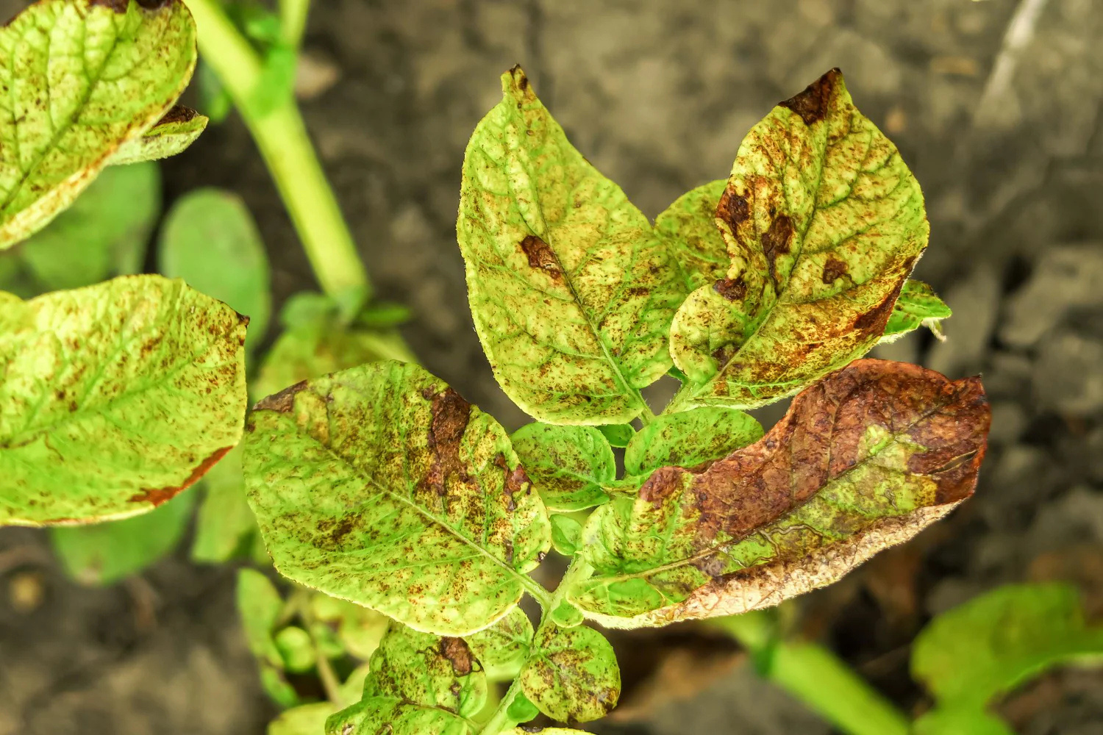

PROBLEM STATEMENT
Plant diseases pose a severe threat to global food security, causing massive economic losses annually. The traditional method of manual diagnosis is labor-intensive, time-consuming, and often prone to human error. Consequently, there is an urgent need for an automated, high-precision AI solution to detect infections early, ensuring timely intervention and protecting crop yields.

Slide 3
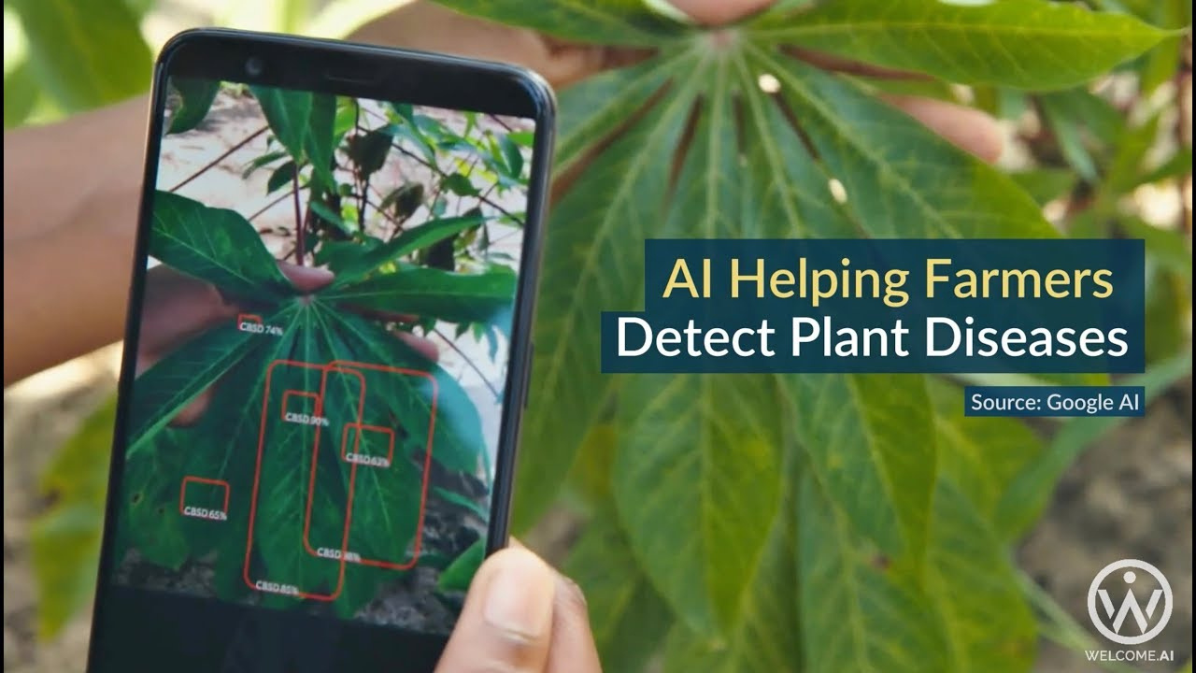
PROJECT MOTIVATION
Plant diseases are a major threat to food security, causing significant economic losses and reducing crop quality. Currently, farmers rely on manual inspection, which is slow, labor-intensive, and prone to human error. There is a critical need for an automated AI solution that can detect diseases early and accurately. This technology empowers farmers to take timely action, reducing waste and ensuring a healthier harvest

Slide 4

PROJECT OBJECTIVES
Develop a robust Deep Learning model using Convolutional Neural Networks (CNNs) capable of accurately classifying 38 distinct plant disease classes. The system is designed to handle complex visual patterns and varying imaging conditions through advanced preprocessing techniques.
Provide an automated, real-time diagnostic tool for precision agriculture. This solution aims to replace time-consuming manual inspections, helping farmers detect infections early, minimize crop losses, and ensure food security

Slide 5
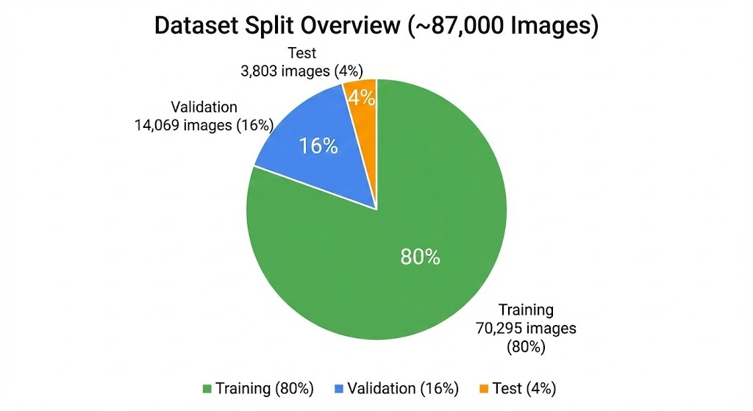
DATASET OVERVIEW
New Plant Diseases Dataset (Kaggle).
~87,000 Images
SOURCE
TOTAL IMAGES
38 Classes (e.g., Apple, Corn, Tomato, Potato).
Training: 70,295 images (80%)
Validation: 14,069 images (16%)
Test: 3,803 images (4%)
CLASSES
DATA SPLIT
“The dataset is well-balanced across classes to prevent bias.”

Slide 6
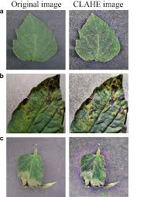
DATA PREPROCESSING
Resizing: All images resized to 128x128 pixels for consistency.
Normalization: Pixel values scaled to range [0, 1] for faster convergence.
CLAHE Technique:
▪️ Applied Contrast Limited Adaptive Histogram Equalization.
▪️ Goal: To enhance the contrast of leaf veins and disease spots.
▪️Benefit: Helps the model focus on texture details rather than lighting.

Slide 7
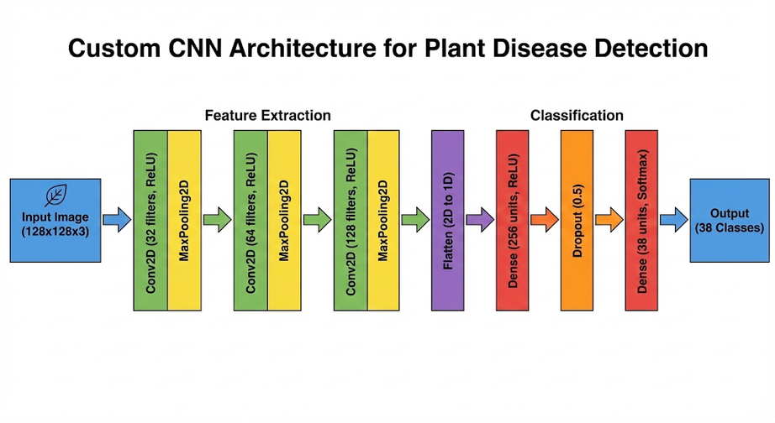
PROPOSED CNN ARCHITECTURE
Architecture Type: Custom Convolutional Neural Network (CNN).
Input Layer: (128, 128, 3).
Feature Extraction:
▪️ Multiple Conv2D Layers (Filters: 32, 64, 128)
▪️ ReLU Activation (Non-linearity).
▪️MaxPooling2D (Dimensionality Reduction).
Classification Head:
▪️ Flatten Layer.
▪️ Dense Layers (Fully Connected).
▪️Output Layer: Softmax (38 Neurons).

Slide 8
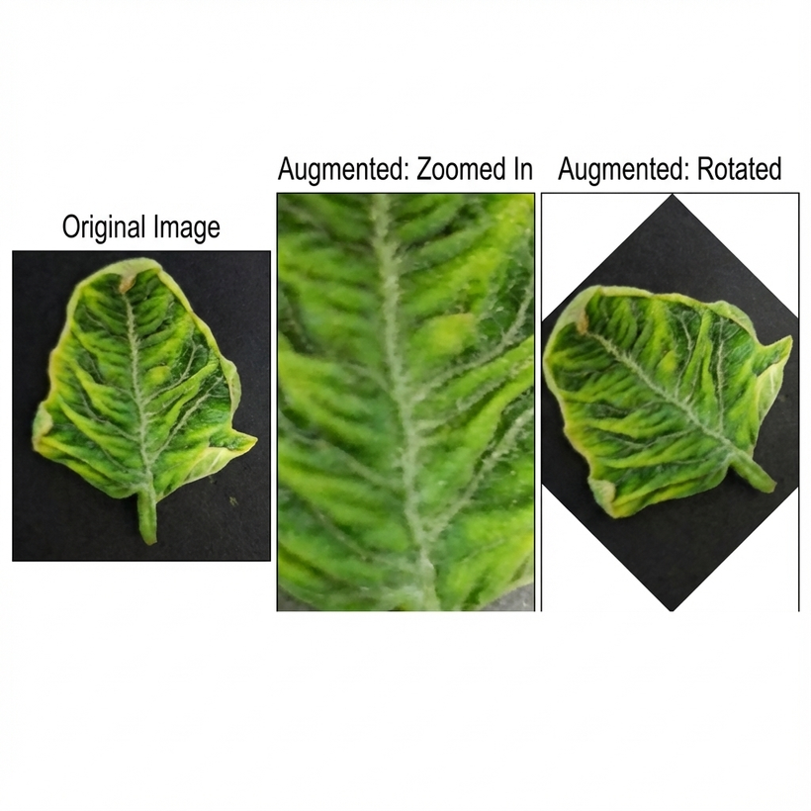
TRAINING STRATEGY
Optimizer: Adam Optimizer (Adaptive learning rate).
Loss Function: Categorical Crossentropy.
Overfitting Handling:
▪️ Data Augmentation: Random rotation, Zoom, Horizontal Flip, Height/Width Shift.
▪️Dropout: Randomly ignoring neurons during training.
▪️MaxPooling2D (Dimensionality Reduction).
Class Imbalance: Calculated and applied Class Weights to ensure fair learning for all diseases.

Slide 9

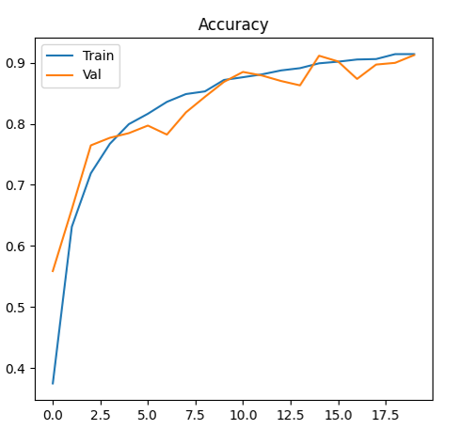
RESULTS
The model achieved a final Test Accuracy of approximately 91%. As shown in the graph, both training and validation accuracy increased steadily, reaching convergence around 20 epochs. The narrow gap between the train and validation curves indicates that the model generalized well to new data without significant overfitting
ACCURACY

Slide 10
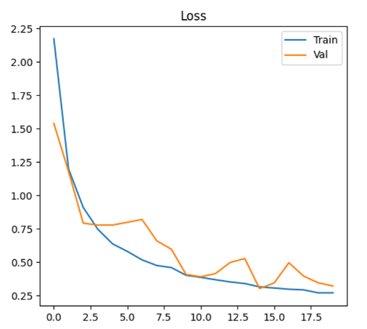
RESULTS
The Cross-Entropy Loss showed a consistent downward trend, stabilizing at a value of ~0.32 for the validation set. This sharp decrease demonstrates the effectiveness of the Adam Optimizer in minimizing prediction errors. The stability of the validation loss confirms that the model learned robust features rather than memorizing the training data.
LOSS

Slide 11
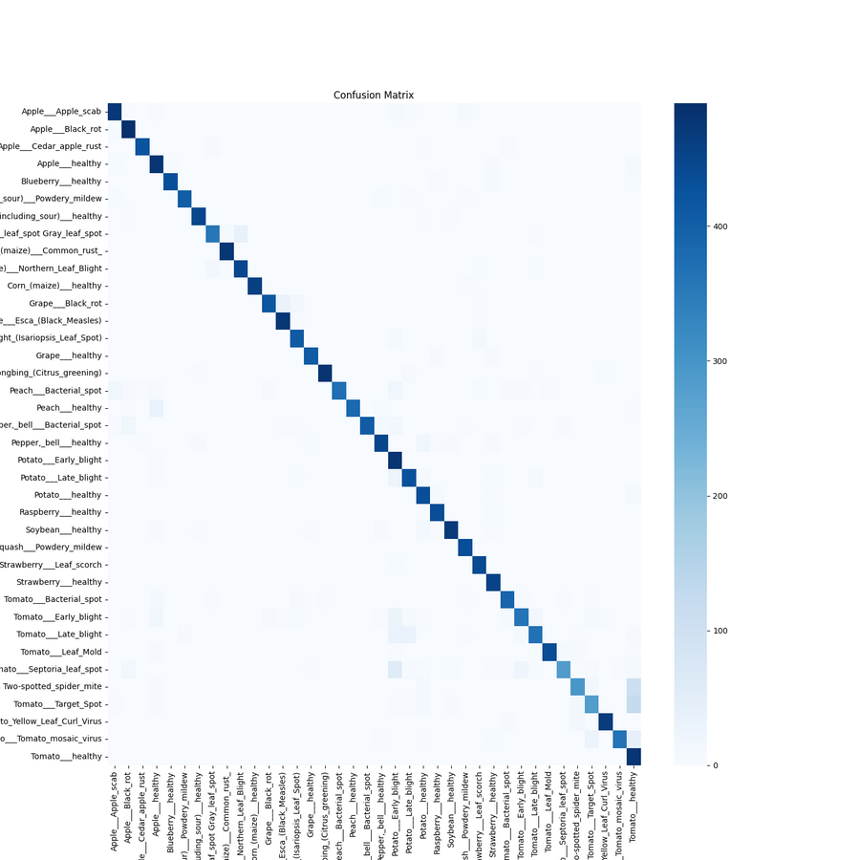
RESULTS
The heatmap displays a strong diagonal dominance, representing correct predictions across the majority of the 38 classes. However, we observed some confusion specifically among Tomato diseases (e.g., Target Spot vs. Spider Mites) due to their high visual similarity. Despite these challenging cases, the model maintained high precision for distinct crops like Corn and Apple
CONFUSION MATRIX

Slide 12
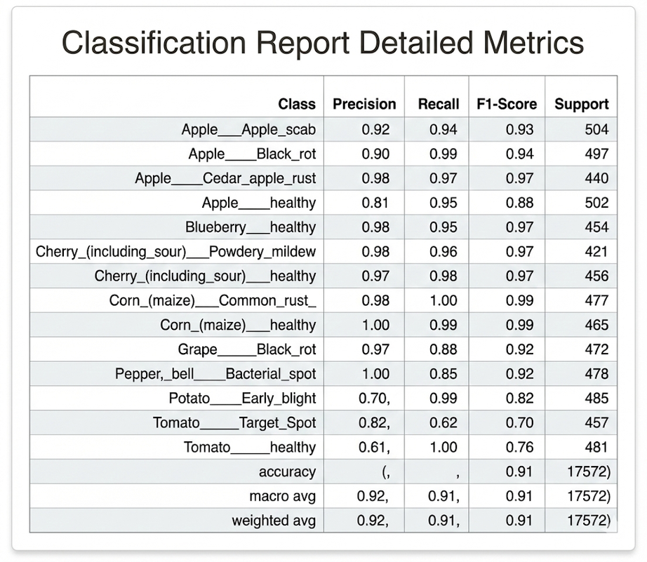
RESULTS
Detailed analysis reveals exceptional performance in specific categories. Classes like Corn (Maize) and Blueberry achieved near-perfect F1-scores ranging from 0.99 to 1.00. The overall Weighted Average F1-Score of 0.91 confirms the reliability of our system across a diverse range of 38 different plant conditions.
CLASSIFICATION REPORT

Slide 13
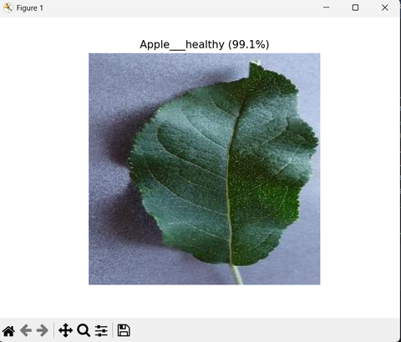
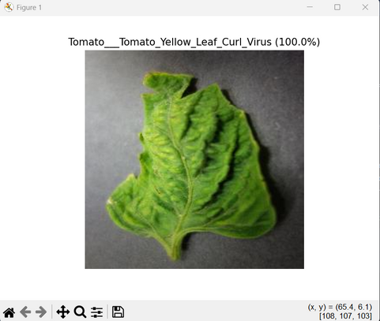
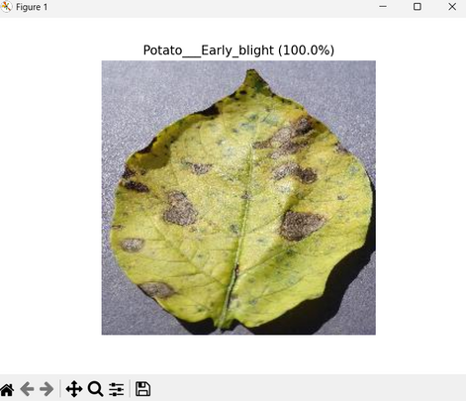
CONCLUSION
Successful Implementation: We successfully developed and trained a custom CNN model that classifies 38 distinct plant disease classes with a high test accuracy of ~91%.
Real-World Impact: The system proves that AI can effectively replace manual inspection, providing a fast, low-cost, and scalable tool for early disease detection and crop protection.
Future Roadmap:
▪️Deployment: Developing a Mobile Application to allow farmers to use the model directly in the field.
▪️Optimization: exploring Transfer Learning (e.g., ResNet, EfficientNet) to further improve distinction between visually similar classes like Tomato diseases

Slide 14

DOES ANYONE HAVE QUESTIONS?

Slide 15
THANK YOU

